Slide 1

Mathe III
Ralf Herbrich
Bayesianische Statistik

Slide 2
Overview
Bayesian Probabilities and Conjugacy
Graphical Models
The Sum-Product Algorithm
Bayesian Ranking: TrueSkill
Information Theory
Arithmetic Coding

Slide 3
Overview
Bayesian Probabilities and Conjugacy
Graphical Models
The Sum-Product Algorithm
Bayesian Ranking: TrueSkill
Information Theory
Arithmetic Coding

Slide 4
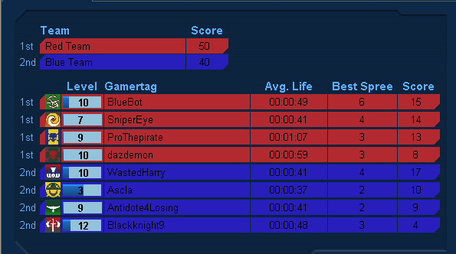

The Skill Rating Problem
Given:
Match outcomes: Orderings among $k$ teams consisting of $n_{1},n_{2},…,n_{k}$ players.
Questions:
Skill $s_{i}$ for each player such that $s_{i}>s_{j}⇔P\left(Player i wins\right)>P\left(Player j wins\right)$
Global ranking among all players
Fair matches between teams of players

Slide 5
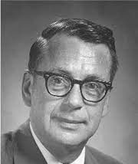
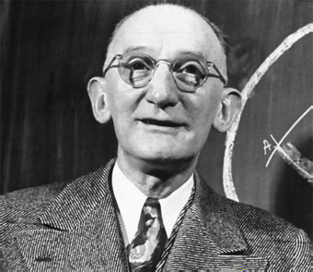
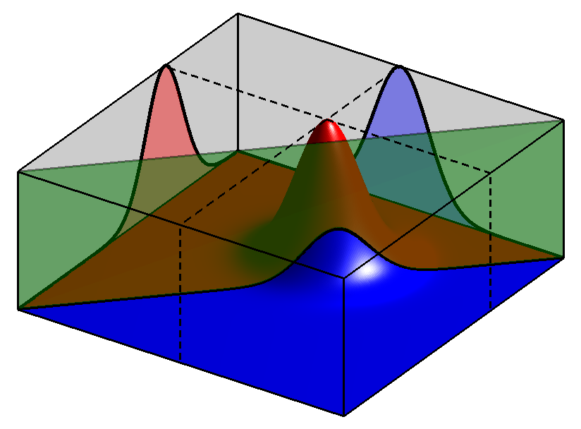
Two-Player Match Outcome Model
Simple Two-Player Games: Our data is the identity $i$ and $j$ of the two players and the outcome $y∈\left\{−1, +1\right\}$ of a match between them
Bradley-Terry Model (1952): Model of a win given skills $s_{i}$ and $s_{j}$ is
$$P\left(y=1|s_{i},s_{j}\right)=\frac{\exp\left(s_{i}\right)}{\exp\left(s_{i}\right)+\exp\left(s_{j}\right)}=\frac{\exp\left(s_{i}−s_{j}\right)}{1+\exp\left(s_{i}−s_{j}\right)}$$
Thurstone Case V Model (1927): Model of a win given skills $s_{i}$ and $s_{j}$ is
$$P\left(y=1|s_{i},s_{j}\right)=\int_{0}^{∞}{𝒩\left(t;s_{i}−s_{j},2β^{2}\right) dt}$$
Logistic sigmoid in skill difference
Ralph A. Bradley (1923 – 2001)
Probit sigmoid in skill difference
Louis Leon Thurstone (1887 – 1955)
$$s_{1}$$
$$s_{2}$$
$$𝒩\left(p_{1};s_{1},β^{2}\right)$$
$$p_{1}$$
$$p_{2}$$
$$𝒩\left(p_{2};s_{2},β^{2}\right)$$
$$0$$
$$p_{2}$$
$$y$$
$$p_{1}$$
$$𝕀\left(y⋅\left(p_{1}−p_{2}\right)>0\right)$$

Slide 6
Two-Team Match Outcome Model
Team Assumption: Skill of a team is the sum of the skill of its players
Pro: Games where the team scores are additive (e.g., kill count in first-person shooter)
Con: Games where the outcome is determined by a single player (e.g., fastest car in a race)
Observation: Match outcomes correlate the skills of players
Same Team: Anti-correlated
Opposite Teams: Correlated
$$s_{1}$$
$$s_{2}$$
$$s_{3}$$
$$s_{4}$$
$$𝒩\left(t_{1};s_{1}+s_{2},{2β}^{2}\right)$$
$$t_{1}$$
$$t_{2}$$
$$𝒩\left(t_{2};s_{3}+s_{4},2β^{2}\right)$$
$$y$$
$$𝕀\left(y⋅\left(t_{1}−t_{2}\right)>0\right)$$

Slide 7
Multi-Team Match Outcome Model
Possible Outcomes: Permutations $y∈{\left\{1,2,3\right\}}^{3}$ of players
Easy to sample for given skills but computationally difficult to ”invert”!
$$s_{1}$$
$$s_{2}$$
$$s_{3}$$
$$s_{4}$$
$$𝒩\left(t_{1};s_{1},β^{2}\right)$$
$$t_{1}$$
$$𝒩\left(t_{2};s_{2}+s_{3},{2β}^{2}\right)$$
$$t_{2}$$
$$t_{3}$$
$$𝒩\left(t_{3}; s_{4},β^{2}\right)$$
$$y$$
Total number of outcomes: $3!$
$$𝕀\left(y=\left(i,j,k\right) if t_{i}>t_{j}>t_{k}\right)$$

Slide 8
From Match Outcomes to Pairwise Rankings
Learning: In the ranking setting, we observe multi-team match outcomes and want to infer the skills!
Idea: Leverage the transitivity of the real line of latent scores!
$$s_{1}$$
$$s_{2}$$
$$s_{3}$$
$$s_{4}$$
$$𝒩\left(t_{1};s_{1},β^{2}\right)$$
$$t_{1}$$
$$𝒩\left(t_{2};s_{2}+s_{3},{2β}^{2}\right)$$
$$t_{2}$$
$$t_{3}$$
$$𝒩\left(t_{3}; s_{4},β^{2}\right)$$
$$y_{1,2}$$
$$y_{2,3}$$
$$𝕀\left(y_{1,2}>0\right)$$
$$𝕀\left(y_{2,3}>0\right)$$
By transitivity, this implies $t_{1}>t_{3}$

Slide 9
TrueSkill Factor Graphs
Bayesian Network
Factor Graph
$$s_{1}$$
$$s_{2}$$
$$s_{3}$$
$$s_{4}$$
$$𝒩\left(s_{i};μ_{i},σ_{i}^{2}\right)$$
$$t_{1}$$
$$t_{2}$$
$$t_{3}$$
$$s_{1}$$
$$s_{2}$$
$$s_{3}$$
$$s_{4}$$
$$𝒩\left(p_{i};s_{i},β^{2}\right)$$
$$y_{1,2}$$
$$y_{2,3}$$
$$p_{1}$$
$$p_{2}$$
$$p_{3}$$
$$p_{4}$$
$$δ\left(t_{i}−\sum_{j}{p_{j}}\right)$$
$$t_{1}$$
$$t_{2}$$
$$t_{3}$$
$$δ\left(d_{i,j}−\left(t_{i}−t_{j}\right)\right)$$
$$d_{1,2}$$
$$d_{2,3}$$
$$𝕀\left(d_{i,j}>0\right)$$

Slide 10
(Approximate) Message Passing in TrueSkill Factor Graphs
TrueSkill Factor Graph
Four Phases
Pass prior messages (1)
Pass messages down to the team performances (2 to 3)
Iterate the approximate messages on the pairwise team differences (4 to 9)
Pass messages back from up from team performances to player skill (10 – 12)
Since this is a tree, the algorithm is guaranteed to converge!
$$𝒩\left(s_{i};μ_{i},σ_{i}^{2}\right)$$
1
1
1
1
$$s_{1}$$
$$s_{2}$$
$$s_{3}$$
$$s_{4}$$
12
12
12
12
$$𝒩\left(p_{i};s_{i},β^{2}\right)$$
2
2
2
2
$$p_{1}$$
$$p_{2}$$
$$p_{3}$$
$$p_{4}$$
11
11
$$δ\left(t_{i}−\sum_{j}{p_{j}}\right)$$
11
11
3
3
3
$$t_{1}$$
$$t_{2}$$
$$t_{3}$$
$$δ\left(d_{i,j}−\left(t_{i}−t_{j}\right)\right)$$
10
6
9
10
4
7
$$d_{1,2}$$
$$d_{2,3}$$
5
8
$$𝕀\left(d_{i,j}>0\right)$$

Slide 11
Message Update Equations
Gaussian Factor
Gaussian Mean Factor
$$m_{f→x}\left(x\right)$$
$$𝒩\left(x;μ,σ^{2}\right)$$
$$m_{f→y}\left(y\right)$$
$$𝒩\left(x;μ,σ^{2}\right)$$
$$x$$
$$x$$
$$y$$
$$𝒩\left(y;x,β^{2}\right)$$
$$m_{f→x}\left(x\right)=𝒩\left(x;μ,σ^{2}\right)$$
$$m_{f→y}\left(y\right)=\int{𝒩\left(y;x,β^{2}\right)⋅𝒩\left(x;μ,σ^{2}\right) dx}=𝒩\left(y;μ,σ^{2}+β^{2}\right)$$
Weighted Sum Factor
Greater-Than Factor
$$x$$
$$y$$
$$δ\left(z−\left(ax+by\right)\right)$$
$${\hat{m}}_{f→x}\left(x\right)$$
$$𝒩\left(x;μ_{x},σ_{x}^{2}\right)$$
$$𝒩\left(y;μ_{y},σ_{y}^{2}\right)$$
$$x$$
$$m_{f→z}\left(z\right)$$
$$𝕀\left(x>0\right)$$
$$𝒩\left(x;μ,σ^{2}\right)$$
$$z$$
Mean and variance of a truncated Gaussian $𝒩\left(x;μ,σ^{2}\right)$
$$m_{f→z}\left(z\right)=𝒩\left(z;aμ_{x}+bμ_{y},a^{2}σ_{x}^{2}+b^{2}σ_{y}^{2}\right)$$
$${\hat{m}}_{f→x}\left(x\right)=\frac{\hat{p}\left(x\right)}{m_{x→f}\left(x\right)}=\frac{𝒩\left(x;\hat{μ},{\hat{σ}}^{2} \right)}{𝒩\left(x;μ,σ^{2}\right)}$$

Slide 12
Truncated Gaussians
Truncated Gaussians. A truncated Gaussian given by $p\left(x\right)∝𝕀\left(x>0\right)⋅𝒩\left(x;μ,σ^{2}\right)$ has the following three moments
$$Z\left(μ,σ\right)= \int_{−∞}^{+∞}{p\left(x\right) dx=1−F\left(0;μ,σ^{2}\right)}$$
$$E\left[X\right]= \int_{−∞}^{+∞}{x⋅p\left(x\right) dx=μ+σ⋅v\left(\frac{μ}{σ}\right)}$$
$$var\left[X\right]= \int_{−∞}^{+∞}{{\left(x−E\left[X\right]\right)}^{2}⋅p\left(x\right) dx=σ^{2}⋅\left(1−w\left(\frac{μ}{σ}\right)\right)}$$
where the probit $F\left(t;μ,σ^{2}\right)≔\int_{−∞}^{t}{𝒩\left(x;μ,σ^{2}\right) dx}$ and
$$v\left(t\right)≔\frac{𝒩\left(t;0,1\right)}{F\left(t;0,1\right)}$$
$$w\left(t\right)≔v\left(t\right)⋅\left[v\left(t\right)+t\right]$$
This can be generalized to an arbitrary interval $\left[a,b\right]$ where the Gaussian is truncated!
Follows from definition of $F$
Additive update that goes to zero as $\frac{μ}{σ}→∞$
Multiplicative update that goes to 1 as $\frac{μ}{σ}→∞$
Converges to $−t$ as $t→−∞$

Slide 13
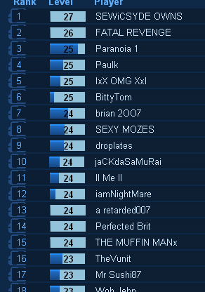
Decision Making: Match Quality and Leaderboards
Match Quality: Decide if two players $i$ and $j$ should be matched
Idea: Pick the pair $\left(i,j\right)$ where the two players have equal skills
$$Quality\left(i,j\right)=\frac{P\left(p_{i}≈p_{j}|μ_{i}−μ_{j},σ_{i}^{2}+σ_{j}^{2}\right)}{P\left(p_{i}≈p_{j}|μ_{i}−μ_{j}=0,σ_{i}^{2}+σ_{j}^{2}=0\right)}$$
Observation: This pair $\left(i,j\right)$ approximately maximizes the information (entropy!) of the predicted match outcome because it gets closest to 50% winning probability
Leaderboard: Decide how to display the best to worst player
Observation: There is an asymmetry in making a ranking mistake
Cheap: Ranking a truly good player lower than they should be (why?)
Expensive: Ranking a truly bad player higher than they should be (why?)
The loss minimizer of this decision process is a quantile $μ−k⋅σ$

Slide 14
Skill Dynamics
Dynamics: In reality, skills of players evolve over time and are not stationary
Idea: Since we do not know which direction, assume that the skill of player $i$ at time $t$ depends on the skill of the same player at time $t−1$ via
$$s_{i,t}∼𝒩\left(s_{i,t};s_{i,t−1},τ^{2}\right)$$
$$s_{1,1}$$
$$s_{1,2}$$
$$s_{1,3}$$
$$p_{1,1}$$
$$p_{1,2}$$
$$p_{1,3}$$
$$d_{1,2}^{(1)}$$
$$d_{1,2}^{(2)}$$
$$d_{1,2}^{(3)}$$
$$p_{2,1}$$
$$p_{2,2}$$
$$p_{2,3}$$
$$s_{2,1}$$
$$s_{2,2}$$
$$s_{2,3}$$

Slide 15
TrueSkill Through Time: Message Schedule
Performance of player 1 in year 1 in second match
Four Phases
Prior (1): Send prior messages to each skill variable for the first year of a player
Annual Matches (2-11): Loop over all (2-player) matches in a year until the skill marginals for all active player in that year does not change (much) anymore
Forward Dynamics (12): Send skill dynamics messages forward in time from $t$ to $t+1$ and keep running step 2. (13 – 17).
Backward Dynamics (18): Send skill dynamics messages backward in time from year $t+1$ to $t$ and keep running step 2. (2-11)
Stop when no variable in the outer loop changes much anymore.
1
$$s_{1,1}$$
18
12
$$s_{1,2}$$
6
11
17
2
7
13
$$p_{1,1,1}$$
$$p_{1,1,2}$$
$$p_{1,2,1}$$
5
10
16
4
$$d_{1,2,1}^{(1)}$$
3
9
$$d_{1,2,2}^{(1)}$$
8
15
$$d_{1,2,1}^{(2)}$$
14
5
10
16
$$p_{2,1,2}$$
$$p_{2,1,2}$$
$$p_{2,2,1}$$
2
7
13
6
11
17
1
$$s_{2,1}$$
18
12
$$s_{2,2}$$
Year 1
Year 2

Slide 16
TrueSkill-Through-Time: Chess Players
Garry Kasparov
3000
2800
Robert James Fischer
Anatoly Karpov
2600
Mikhail Botvinnik
History of Chess 3.5M match outcomes 20 million variables
40 million factors
2400
Paul Morphy
Skill estimate
Whilhelm Steinitz
2200
Boris V Spassky
2000
Emanuel Lasker
1800
Jose Raul Capablanca
1600
Adolf Anderssen
1400
1850
1858
1866
1875
1883
1891
1899
1907
1916
1924
1932
1940
1949
1957
1965
1973
1981
1990
1998
2006
Year

Slide 17
Overview
Bayesian Probabilities and Conjugacy
Graphical Models
The Sum-Product Algorithm
Bayesian Ranking: TrueSkill
Information Theory
Arithmetic Coding

Slide 18



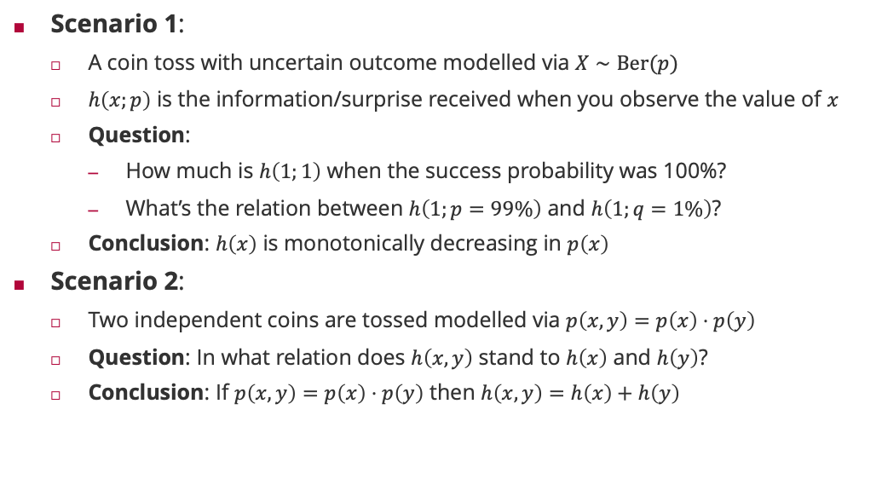






Motivating Example: Information and Coin Tosses
$$h\left(x,y\right) =h\left(x\right)+h\left(y\right)$$
$$h\left(x,y\right) >h\left(x\right)+h\left(y\right)$$
Scenario 1:
A coin toss with uncertain outcome modelled via $X∼Ber(p)$
$h\left(x;p\right)$ is the information/surprise received when you observe the value of $x$
Question:
How much is $h\left(1;1\right)$ when the success probability was 100%?
What’s the relation between $h\left(1;p=99\%\right)$ and $h\left(1;q=1\%\right)$?
Conclusion: $h\left(x\right)$ is monotonically decreasing in $p\left(x\right)$
Scenario 2:
Two independent coins are tossed modelled via $p\left(x,y\right)=p\left(x\right)⋅p\left(y\right)$
Question: In what relation does $h\left(x,y\right)$ stand to $h\left(x\right)$ and $h\left(y\right)$?
Conclusion: If $p\left(x,y\right)=p\left(x\right)⋅p\left(y\right)$ then $h\left(x,y\right)=h\left(x\right)+h\left(y\right)$
$$h\left(1;p\right)>h\left(1;q\right)$$
$$h(1;1) = 0$$
$$h\left(1;p\right)<h\left(1;q\right)$$
$$h\left(1;1\right)> 0$$
$$h\left(x,y\right) <h\left(x\right)+h\left(y\right)$$
$$h\left(1;p\right)=h\left(1;q\right)$$
$$h\left(x\right)=−\log_{b}\left(p\left(x\right)\right)⁡$$

Slide 19
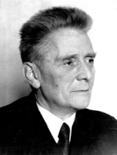
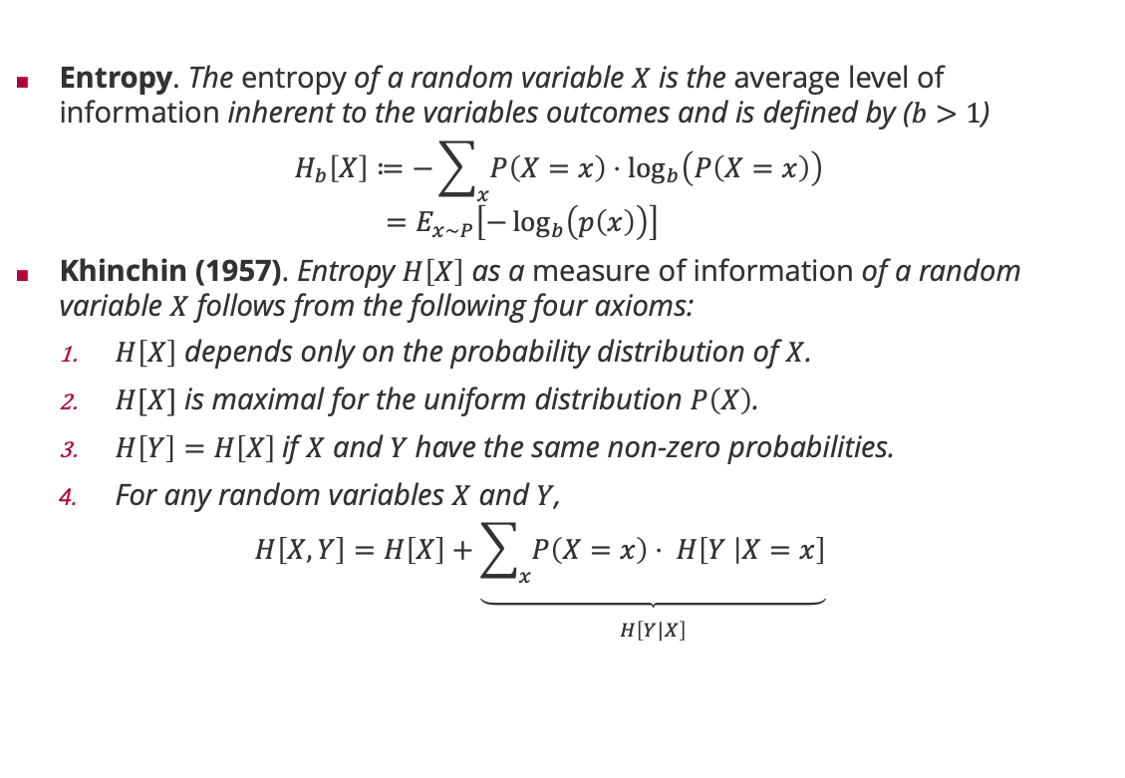
Measure of Information: Entropy
Entropy. The entropy of a random variable $X$ is the average level of information inherent to the variables outcomes and is defined by ($b>1$)
$$H_{b}\left[X\right]≔−\sum_{x}{P\left(X=x\right)⋅\log_{b}\left(P\left(X=x\right)\right) } \\ =E_{x∼P}\left[−\log_{b}\left(p\left(x\right)\right)\right]$$
Khinchin (1957). Entropy $H\left[X\right]$ as a measure of information of a random variable $X$ follows from the following four axioms:
$H\left[X\right]$ depends only on the probability distribution of $X$.
$H[X]$ is maximal for the uniform distribution $P\left(X\right)$.
$H\left[Y\right]=H\left[X\right]$if $X$ and $Y$have the same non-zero probabilities.
For any random variables $X$ and $Y$,
$$H\left[X, Y\right]=H\left[X\right]+\underset{\begin{aligned} \\ H\left[Y|X\right]\end{aligned}}{\underbrace{\sum_{x}{P\left(X=x\right)⋅ H\left[Y | X=x\right]}}}$$
Aleksandr Khinchin (1894 – 1959)

Slide 20

Example: Binary Entropy
$$H_{2}\left[p\right]=p⋅\log_{2}\left(p\right)+\left(1−p\right)⋅\log_{2}\left(1−p\right)$$

Slide 21
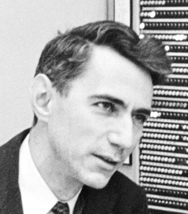
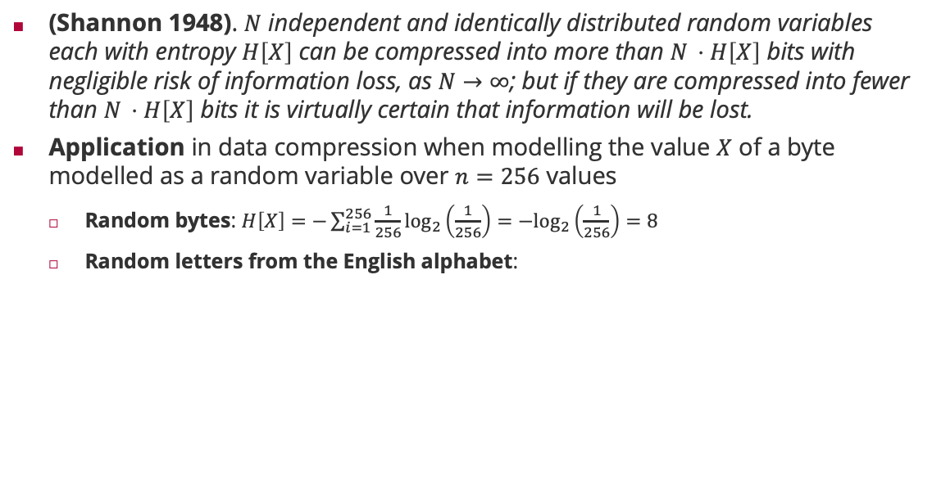

Entropy and the Noiseless Coding Theorem
(Shannon 1948). $N$ independent and identically distributed random variables each with entropy $H\left[X\right]$ can be compressed into more than $N ⋅H\left[X\right]$ bits with negligible risk of information loss, as $N→∞$; but if they are compressed into fewer than $N ⋅H\left[X\right]$ bits it is virtually certain that information will be lost.
Application in data compression when modelling the value $X$ of a byte modelled as a random variable over $n=256$ values
Random bytes: $H\left[X\right]=−\sum_{i=1}^{256}{\frac{1}{256}\log_{2}\left(\frac{1}{256}\right)=−\log_{2}\left(\frac{1}{256}\right)=8}$
Random letters from the English alphabet:
Claude Shannon (1913 – 2001)
$$H = 4.48917$$

Slide 22
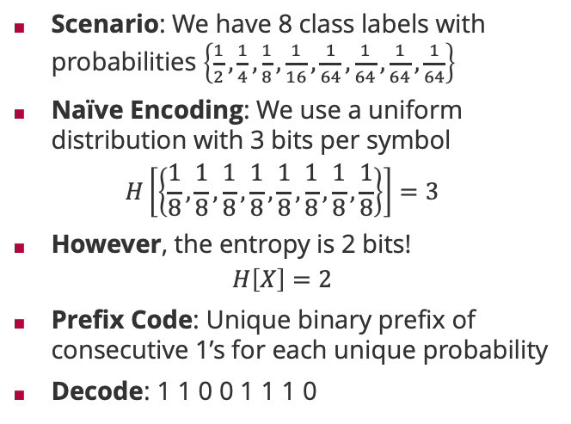

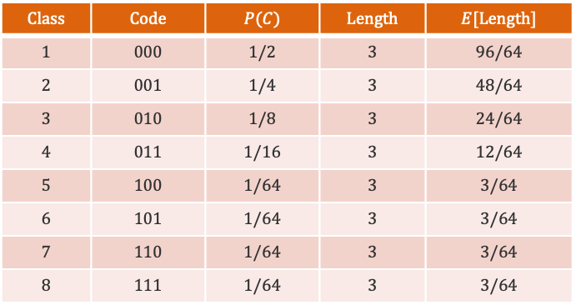


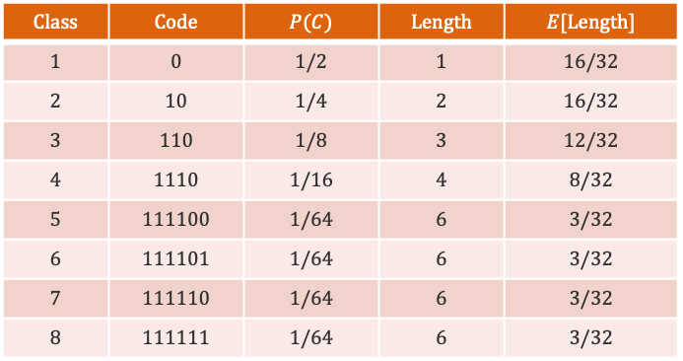
Noiseless Coding Theorem: An Example
Scenario: We have 8 class labels with probabilities $\left\{\frac{1}{2},\frac{1}{4},\frac{1}{8},\frac{1}{16},\frac{1}{64},\frac{1}{64},\frac{1}{64},\frac{1}{64}\right\}$
Naïve Encoding: We use a uniform distribution with 3 bits per symbol
$$H\left[\left\{\frac{1}{8},\frac{1}{8},\frac{1}{8},\frac{1}{8},\frac{1}{8},\frac{1}{8},\frac{1}{8},\frac{1}{8}\right\}\right]=3$$
However, the entropy is 2 bits!
$$H\left[X\right]=2$$
Prefix Code: Unique binary prefix of consecutive 1’s for each unique probability
Decode: 1 1 0 0 1 1 1 0
$$Class$$ | $$Code$$ | $$P(C)$$ | $$Length$$ | $$E[Length]$$
$$1$$ | $$0$$ | $$1/2$$ | $$1$$ | $$16/32$$
$$2$$ | $$10$$ | $$1/4$$ | $$2$$ | $$16/32$$
$$3$$ | $$110$$ | $$1/8$$ | $$3$$ | $$12/32$$
$$4$$ | $$1110$$ | $$1/16$$ | $$4$$ | $$8/32$$
$$5$$ | $$111100$$ | $$1/64$$ | $$6$$ | $$3/32$$
$$6$$ | $$111101$$ | $$1/64$$ | $$6$$ | $$3/32$$
$$7$$ | $$111110$$ | $$1/64$$ | $$6$$ | $$3/32$$
$$8$$ | $$111111$$ | $$1/64$$ | $$6$$ | $$3/32$$
$$Class$$ | $$Code$$ | $$P(C)$$ | $$Length$$ | $$E[Length]$$
$$1$$ | $$000$$ | $$1/2$$ | $$3$$ | $$96/64$$
$$2$$ | $$001$$ | $$1/4$$ | $$3$$ | $$48/64$$
$$3$$ | $$010$$ | $$1/8$$ | $$3$$ | $$24/64$$
$$4$$ | $$011$$ | $$1/16$$ | $$3$$ | $$12/64$$
$$5$$ | $$100$$ | $$1/64$$ | $$3$$ | $$3/64$$
$$6$$ | $$101$$ | $$1/64$$ | $$3$$ | $$3/64$$
$$7$$ | $$110$$ | $$1/64$$ | $$3$$ | $$3/64$$
$$8$$ | $$111$$ | $$1/64$$ | $$3$$ | $$3/64$$
$$C_{3}$$
$$C_{1}$$
$$C_{4}$$

Slide 23
Overview
Bayesian Probabilities and Conjugacy
Graphical Models
The Sum-Product Algorithm
Bayesian Ranking: TrueSkill
Information Theory
Arithmetic Coding

Slide 24



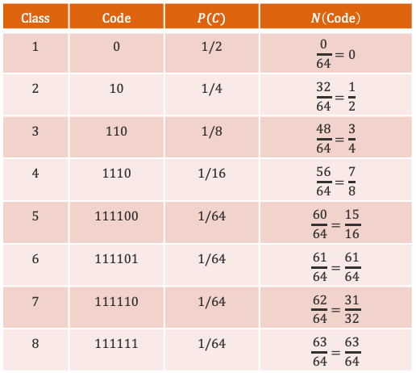


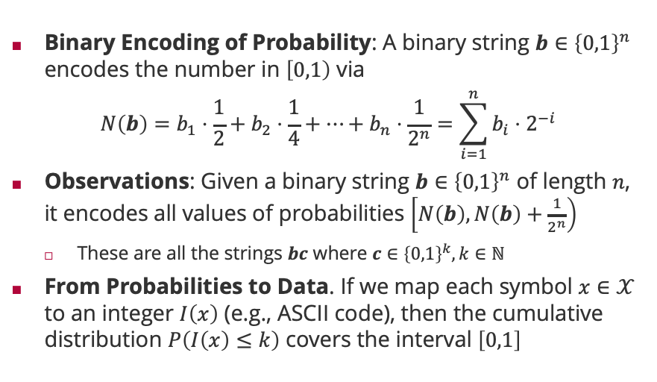







Arithmetic Coding
Binary Encoding of Probability: A binary string $b∈{\left\{0,1\right\}}^{n}$ encodes the number in $\left[0,1\right)$ via
$$N\left(b\right)=b_{1}⋅\frac{1}{2}+b_{2}⋅\frac{1}{4}+⋯+b_{n}⋅\frac{1}{2^{n}}=\sum_{i=1}^{n}{{b_{i}⋅2}^{−i}}$$
Observations: Given a binary string $b∈{\left\{0,1\right\}}^{n}$ of length $n$, it encodes all values of probabilities $\left[N\left(b\right),N\left(b\right)+\frac{1}{2^{n}}\right)$
These are all the strings $bc$ where $c∈{\left\{0,1\right\}}^{k}, k∈ℕ$
From Probabilities to Data. If we map each symbol $x∈𝒳$ to an integer $I\left(x\right)$ (e.g., ASCII code), then the cumulative distribution $P\left(I\left(x\right)≤k\right)$ covers the interval $\left[0,1\right]$
$$Class$$ | $$Code$$ | $$P(C)$$ | $$N\left(Code\right)$$
$$1$$ | $$0$$ | $$1/2$$ | $$\frac{0}{64}=0$$
$$2$$ | $$10$$ | $$1/4$$ | $$\frac{32}{64}=\frac{1}{2}$$
$$3$$ | $$110$$ | $$1/8$$ | $$\frac{48}{64}=\frac{3}{4}$$
$$4$$ | $$1110$$ | $$1/16$$ | $$\frac{56}{64}=\frac{7}{8}$$
$$5$$ | $$111100$$ | $$1/64$$ | $$\frac{60}{64}=\frac{15}{16}$$
$$6$$ | $$111101$$ | $$1/64$$ | $$\frac{61}{64}=\frac{61}{64}$$
$$7$$ | $$111110$$ | $$1/64$$ | $$\frac{62}{64}=\frac{31}{32}$$
$$8$$ | $$111111$$ | $$1/64$$ | $$\frac{63}{64}=\frac{63}{64}$$
$$C_{1}$$
$$C_{2}$$
$$C_{3}$$
$$C_{4}$$
$$C_{5}$$
$$C_{6}$$
$$C_{7}$$
$$C_{8}$$
$$1.000000$$
$$0.000000$$
$$0.110000$$
$$0.111000$$
$$0.111101$$
$$0.111111$$
$$0.100000$$
$$0.111100$$
$$0.111110$$

Slide 25
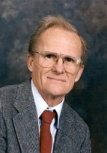
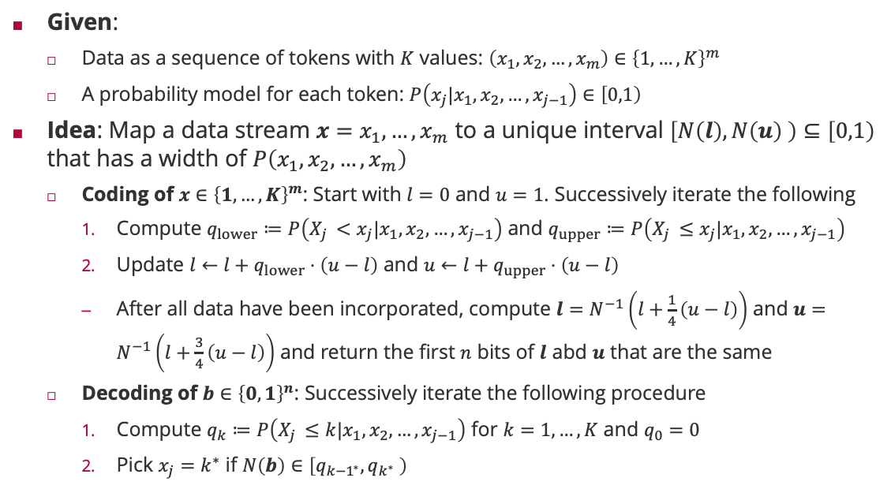
Arithmetic Coding: Algorithm
Given:
Data as a sequence of tokens with $K$ values: $\left(x_{1},x_{2},…,x_{m}\right)∈{\left\{1,…,K\right\}}^{m}$
A probability model for each token: $P\left(x_{j}|x_{1},x_{2},…,x_{j−1}\right)∈\left[0,1\right)$
Idea: Map a data stream $x=x_{1}, …,x_{m}$ to a unique interval $\left[N\left(l\right),N\left(u\right) \right)⊆\left[0,1\right)$ that has a width of $P\left(x_{1},x_{2},…,x_{m}\right)$
Coding of $x∈{\left\{1,…,K\right\}}^{m}$: Start with $l=0$ and $u=1$. Successively iterate the following
Compute $q_{lower}≔P\left(X_{j }<x_{j}|x_{1},x_{2},…,x_{j−1}\right)$ and $q_{upper}≔P\left(X_{j }≤x_{j}|x_{1},x_{2},…,x_{j−1}\right)$
Update $l←l+q_{lower}⋅\left(u−l\right)$ and $u←l+q_{upper}⋅\left(u−l\right)$
After all data have been incorporated, compute $l=N^{−1}\left(l+\frac{1}{4}\left(u−l\right)\right)$ and $u=N^{−1}\left(l+\frac{3}{4}\left(u−l\right)\right)$ and return the first $n$ bits of $l$ abd $u$ that are the same
Decoding of $b∈{\left\{0,1\right\}}^{n}$: Successively iterate the following procedure
Compute $q_{k}≔P\left(X_{j }≤k|x_{1},x_{2},…,x_{j−1}\right)$ for $k=1,…,K$ and $q_{0}=0$
Pick $x_{j}=k^{∗}$ if $N\left(b\right)∈\left[q_{{k−1}^{∗}},q_{k^{∗}} \right)$
Jorma Rissanen (1932 – 2020)

Slide 26



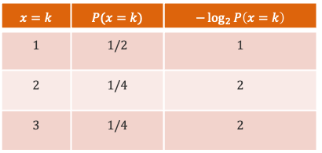







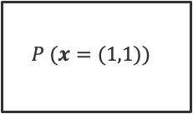







Arithmetic Coding: An Example
$$x=k$$ | $$P(x=k)$$ | $$−\log_{2}{P\left(x=k\right)}$$
$$1$$ | $$1/2$$ | $$1$$
$$2$$ | $$1/4$$ | $$2$$
$$3$$ | $$1/4$$ | $$2$$
$$0$$
$$0$$
$$x=\left(1,2\right)$$
$$P(x_{1}=1)$$
$$P (x=(1,1))$$
$$\frac{1}{4}$$
$$P (x=\left(1,2\right))$$
$$\frac{3}{8}$$
$$b=\left(0,1,0\right)$$
$$P (x=\left(1,3\right))$$
$$\frac{1}{2}$$
$$\frac{1}{2}$$
$$P(x_{1}=2)$$
$$l=\frac{1}{4}+\frac{1}{4}⋅\frac{1}{8}=\frac{9}{32}={0.01001}_{2}$$
$$\frac{3}{4}$$
$$u=\frac{1}{4}+\frac{3}{4}⋅\frac{1}{8}=\frac{11}{32}={0.01011}_{2}$$
$$P(x_{1}=3)$$
$$1$$

Slide 27

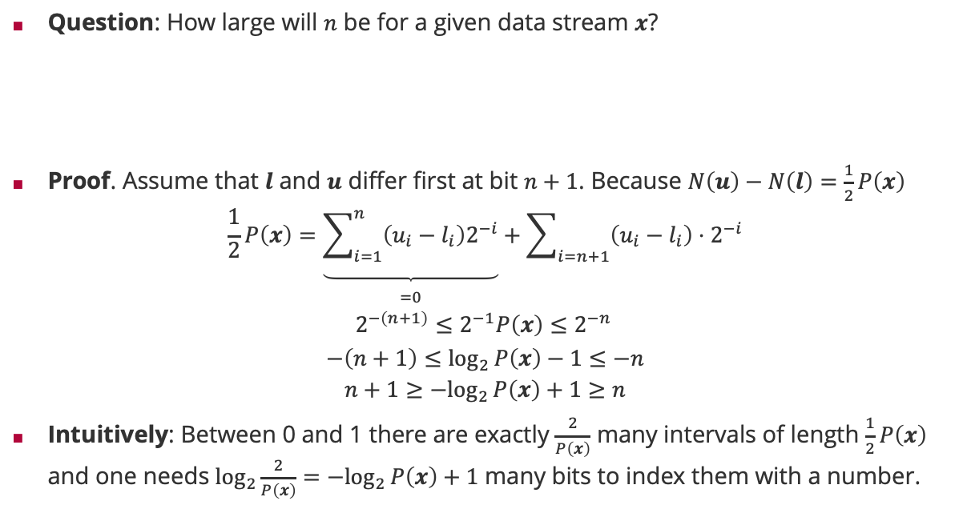
Arithmetic Coding: Optimal Code Length
Question: How large will $n$ be for a given data stream $x$?
Proof. Assume that $l$ and $u$ differ first at bit $n+1$. Because $N\left(u\right)−N\left(l\right)=\frac{1}{2}P\left(x\right)$
$$\frac{1}{2}P\left(x\right)=\underset{\begin{aligned} \\ =0\end{aligned}}{\underbrace{\sum_{i=1}^{n}{\left(u_{i}−l_{i}\right)2^{−i}}}}+\sum_{i=n+1}{\left(u_{i}−l_{i}\right)⋅2^{−i}}$$
$$2^{−\left(n+1\right)}≤2^{−1}P\left(x\right)≤2^{−n }$$
$$−\left(n+1\right)≤\log_{2}{P\left(x\right)−1}≤−n$$
$$n+1≥{−log}_{2}{P\left(x\right)}+1≥n$$
Intuitively: Between 0 and 1 there are exactly $\frac{2}{P\left(x\right)}$ many intervals of length $\frac{1}{2}P\left(x\right)$ and one needs $\log_{2}\frac{2}{P\left(x\right)}={−log}_{2}{P\left(x\right)}+1$ many bits to index them with a number.
$$−\log_{2}{P\left(x\right)}≤n≤−\log_{2}{P\left(x\right)}+1$$

Slide 28
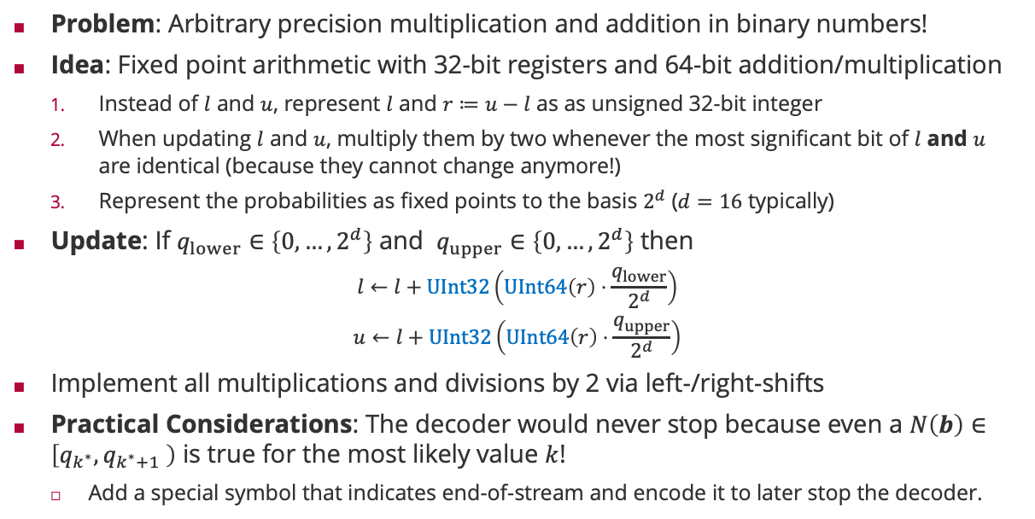
Arithmetic Coding: Fixed Point Arithmetic
Problem: Arbitrary precision multiplication and addition in binary numbers!
Idea: Fixed point arithmetic with 32-bit registers and 64-bit addition/multiplication
Instead of $l$ and $u$, represent $l$ and $r≔u−l$ as as unsigned 32-bit integer
When updating $l$ and $u$, multiply them by two whenever the most significant bit of $l$ and $u$ are identical (because they cannot change anymore!)
Represent the probabilities as fixed points to the basis $2^{d}$ ($d=16$ typically)
Update: If $q_{lower}∈\left\{0,…,2^{d}\right\}$ and $q_{upper}∈\left\{0,…,2^{d}\right\}$ then
$$l←l+UInt32\left(UInt64\left(r\right)⋅\frac{q_{lower}}{2^{d}}\right)$$
$$u←l+UInt32\left(UInt64\left(r\right)⋅\frac{q_{upper}}{2^{d}}\right)$$
Implement all multiplications and divisions by 2 via left-/right-shifts
Practical Considerations: The decoder would never stop because even a $N\left(b\right)∈\left[q_{k^{∗}},q_{k^{∗}+1} \right)$ is true for the most likely value $k$!
Add a special symbol that indicates end-of-stream and encode it to later stop the decoder.

Slide 29
Viel Spaß bis zur nächsten Vorlesung!

